Slide 1



Smart Automate Irrigation Using Soil Moisture And Weather Data.
DEVADHARSHANI B
AICTE Student ID: STU682020619f5641746935905
AICTE Internship ID: INTERNSHIP_1748923002683e727a876ea
Email: devadharshai13@gmail.com

Slide 2

Learning Objectives
To understand how AI and machine learning can be applied in smart irrigation systems.
To learn how to clean and preprocess real sensor data effectively.
To apply feature scaling techniques using MinMaxScaler.
To implement a multi-output classification model using Random Forest.
To evaluate model performance using classification reports.
To visualize irrigation patterns and pump activity using matplotlib.
To save and load models using joblib for reuse.
To build an interactive prediction app using Streamlit.
To connect machine learning concepts with real-time decision-making in agriculture.
To improve overall confidence in developing and deploying data-driven projects.
GOAL
Source :
www.freepik.com/

Slide 3
Tools and Technology used
Programming Language:
Python(3.12.0)
Development Environment:
VS Code-Streamlit
Machine Learning Algorithm:
Random Forest Classifier
MultiOutputClassifier (for multiple outputs)
Libraries Used:
pandas – for data handling
numpy – for numerical operations
matplotlib – for data visualization
scikit-learn (sklearn) – for ML models and preprocessing
joblib – for saving the model
streamlit – for building the interactive web interface

Slide 4
Methodology
Understanding the Problem Statement:
The aim was to automate sprinkler control using real-time sensor data from multiple regions (parcels) in a farm.
The system should decide whether to turn ON or OFF sprinklers based on environmental conditions sensed.
Data Collection & Inspection:
A dataset containing *20 sensor readings* (e.g., temperature, humidity, soil moisture, etc.) and *3 binary labels* (parcel_0, parcel_1, parcel_2) was provided.
Basic statistics and shape were analyzed to understand the structure and distribution of features and target variables.
Data Preprocessing:
Removed unnecessary columns like 'Unnamed: 0’.
Scaled the sensor data using *MinMaxScaler* to bring all values between 0 and 1 for consistent model performance.
Split the data into *training* and *testing sets* using an 80/20 ratio.
Model Selection & Training:
Used *Random Forest Classifier* as the base model due to its robustness and accuracy in handling tabular data.
Implemented *MultiOutputClassifier* to allow simultaneous prediction of the 3 sprinkler statuses.
Tuned hyperparameters like n_estimators, max_depth, and min_samples_split to enhance model performance.

Slide 5
Methodology
Model Evaluation:
Tested the model on the unseen test set.
Evaluated using a *classification report* that included precision, recall, and F1-score for each sprinkler.
Visualized how the sprinklers responded over time using step plots.
Model Saving:
Saved the trained model and scaler using *joblib* into a .pkl file named Farm_Irrigation_System.pkl.
Web Application Deployment:
Developed a *Streamlit application* to make predictions using new sensor values entered by users.
Designed an interactive UI with sliders for all 20 sensors.
Displayed prediction results as ON/OFF status for each sprinkler.

Slide 6
Problem Statement:
1.Over-Irrigation:
Excess water application can damage crops, cause root rot, and waste water resources.
2. Under-Irrigation:
Insufficient water supply leads to poor plant growth, reduced yield, and crop stress.
3. Manual Dependency:
Most traditional systems require manual operation, making them time-consuming and error-prone.
4. Uneven Water Distribution:
Lack of automation causes irregular coverage, resulting in dry patches or water-logged areas.
5. Water Wastage:
Continuous water supply without sensor-based control results in unnecessary usage, especially in regions facing water scarcity.
6. No Real-Time Decision Making:
Without data-driven automation, irrigation systems can't adapt to weather or soil condition changes effectively.

Slide 7
Solution:
1. Smart Decision Making with Machine Learning:
By using a Random Forest Classifier and sensor data, the model predicts whether sprinklers (parcels) should be turned ON or OFF. This makes irrigation data-driven, removing guesswork and minimizing human errors in water application.
2.Avoids Over and Under-Irrigation:
The trained model uses real-time sensor inputs (like soil moisture, humidity, temperature, etc.) to determine the right amount of water needed. This helps prevent overwatering (which causes root rot and waste) and underwatering(which stunts plant growth).
3.Automation of Sprinklers:
Instead of manual irrigation, the system predicts when and where to irrigate using automated sprinkler control. This reduces manual labor, saves time, and ensures timely watering based on actual conditions.
4.Optimized Water Usage:
By activating sprinklers only when necessary, the system saves water. This leads to better water management, reduces groundwater depletion, and supports sustainable agriculture.

Slide 8
Solution:
5. Scalable and Adaptable:
The solution is built to handle multiple sensor inputs and multiple farm zones (parcels). It can be easily extended to larger farms with more sensors, adapting to different crop types and soil needs.
6. Visualization for Monitoring:
The project includes visualizations showing sprinkler activity over time. Farmers or researchers can use these plots to monitor trends and improve irrigation strategies, making it easy to interpret and trust the system’s decisions.
GIT LINK:

Slide 9
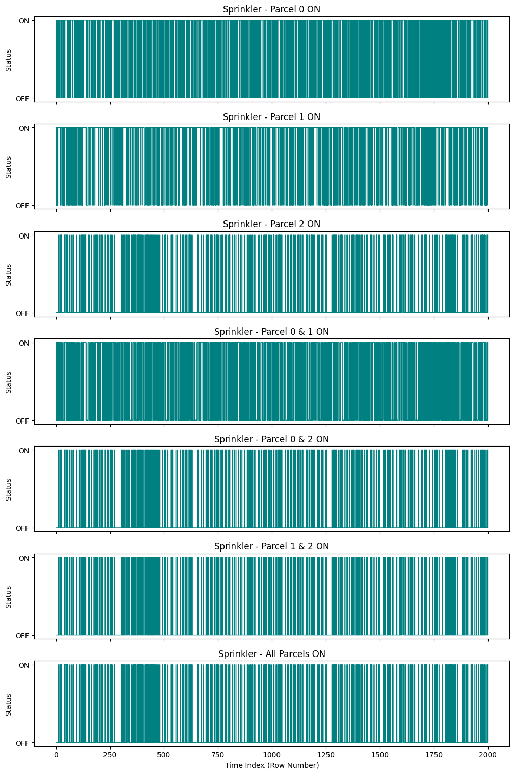
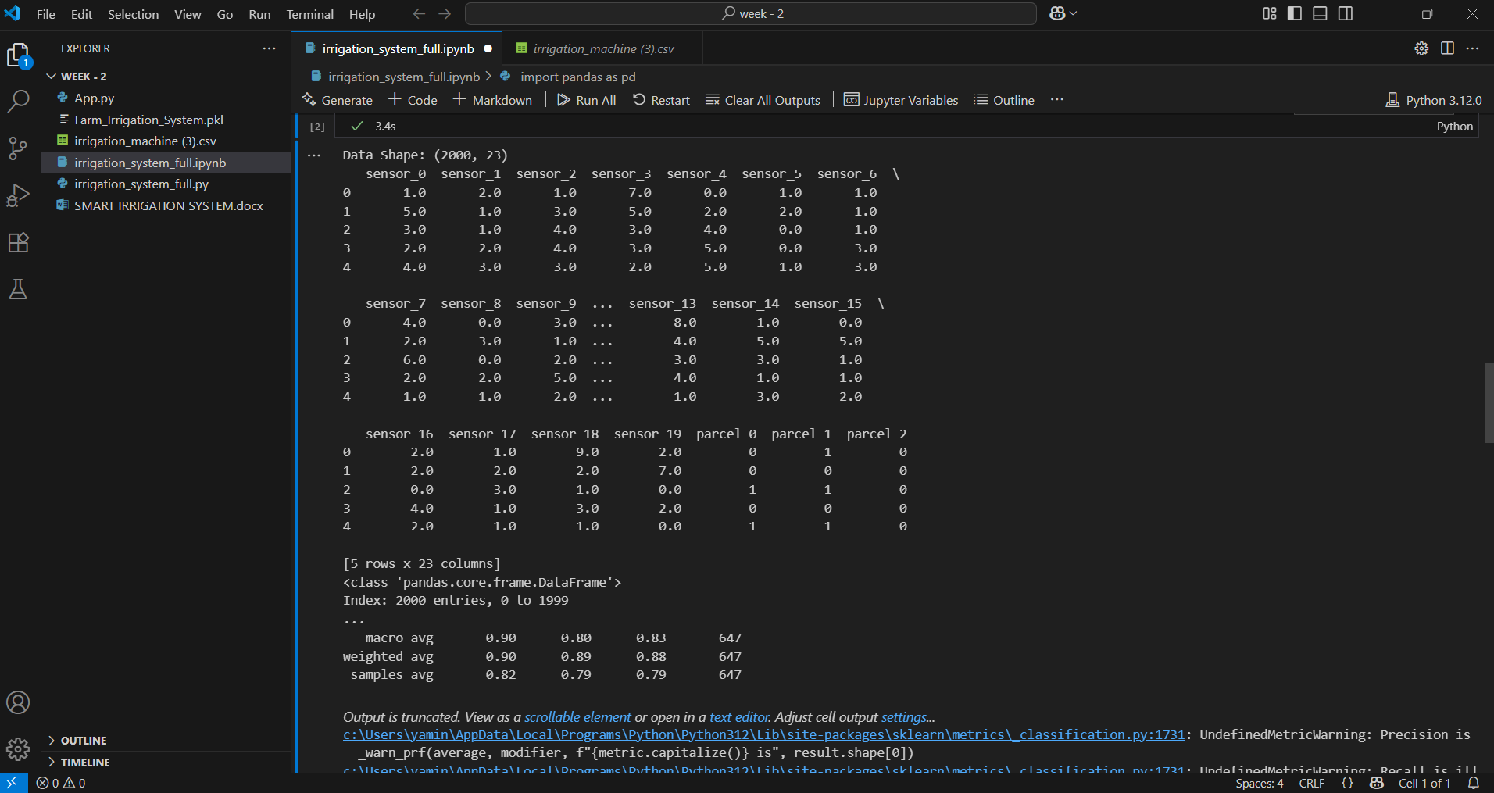
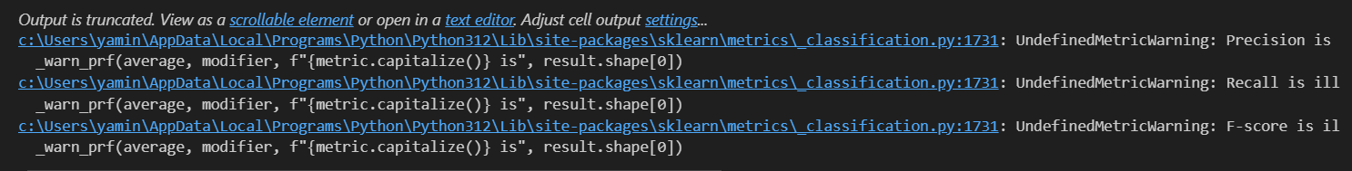
Screenshot of Output:
Visualization of sprinkler activity

Slide 10
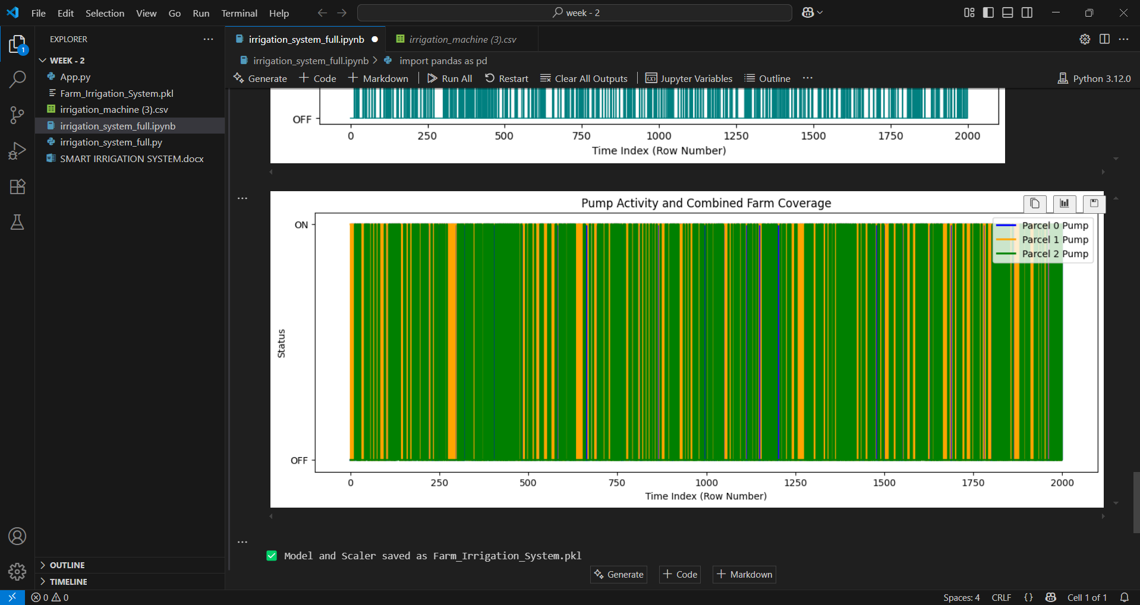
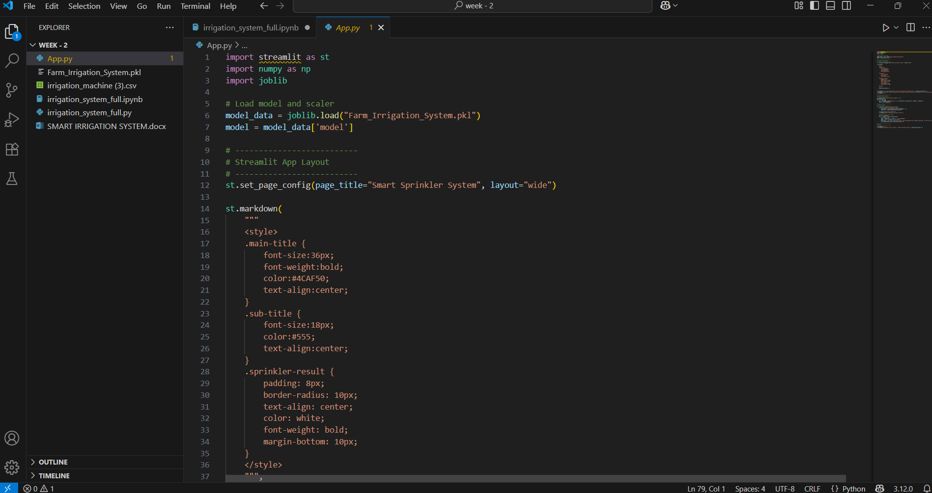
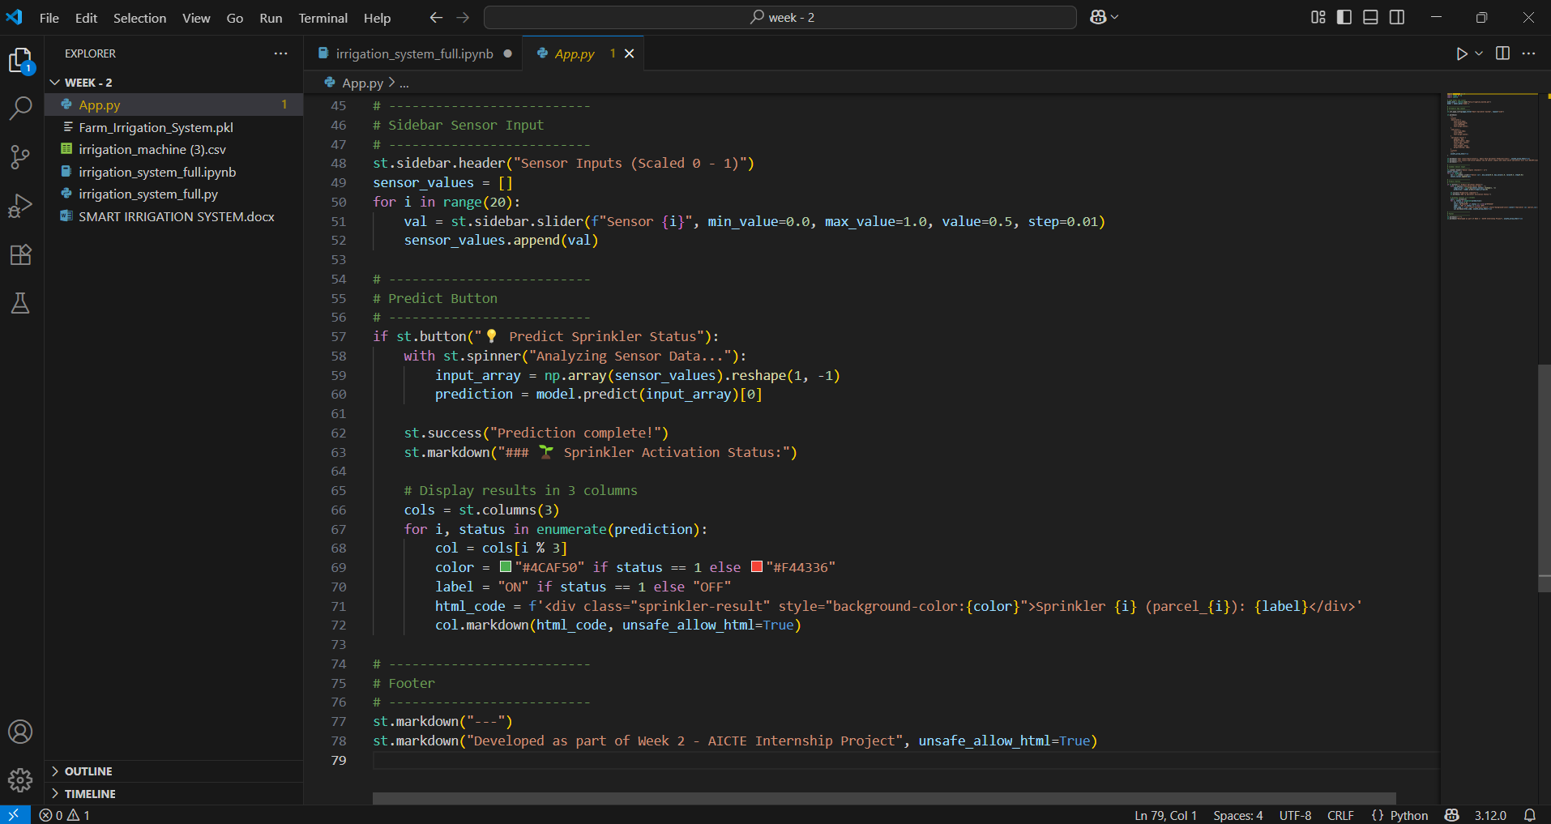
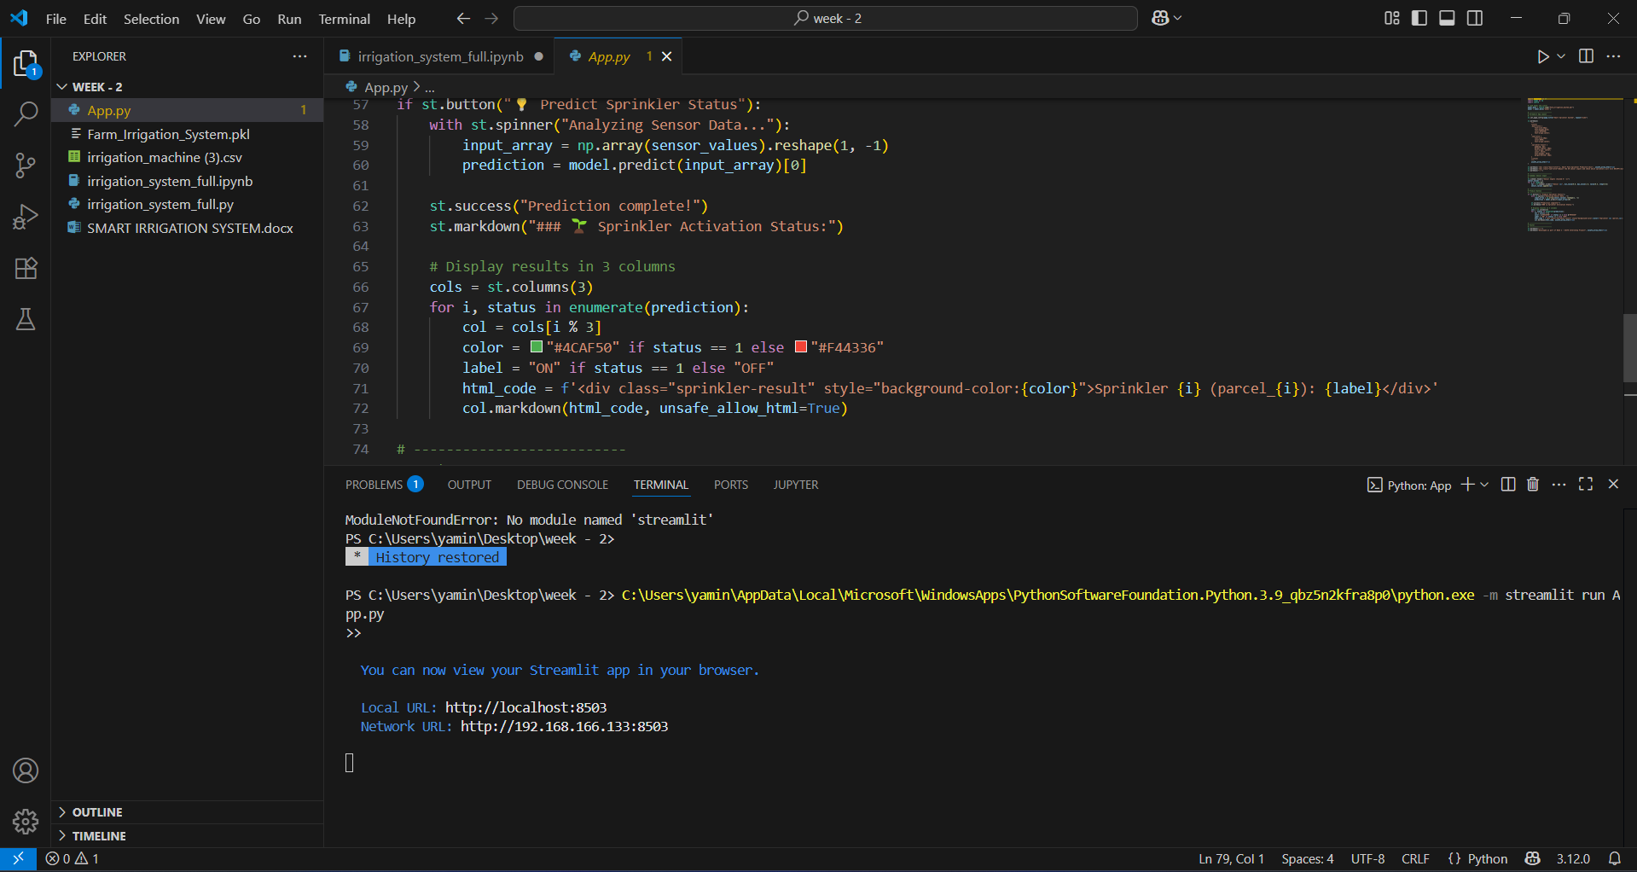
Screenshot of Output:
Time-based visualization of pump activity
---> Before running the Python code(App.py)
--->

Slide 11
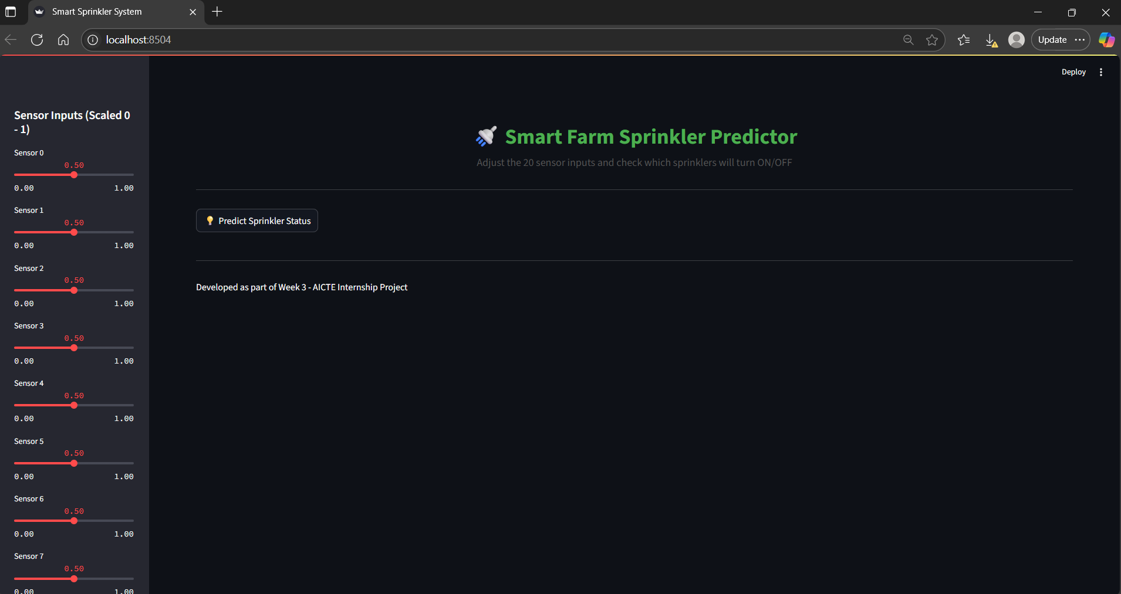
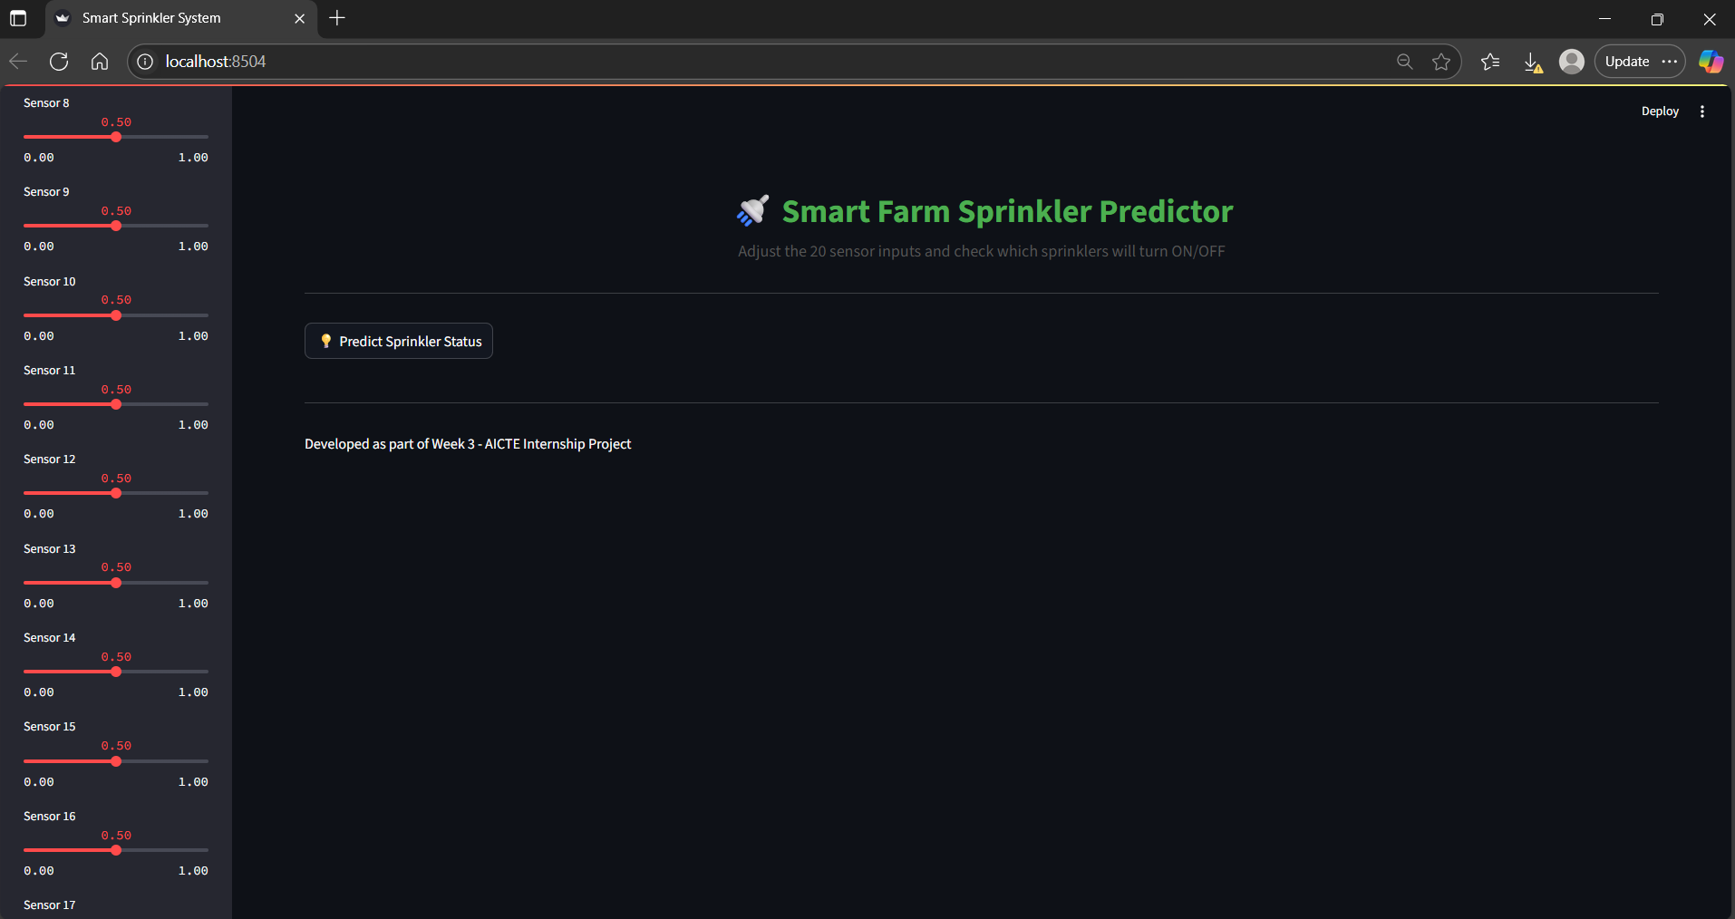
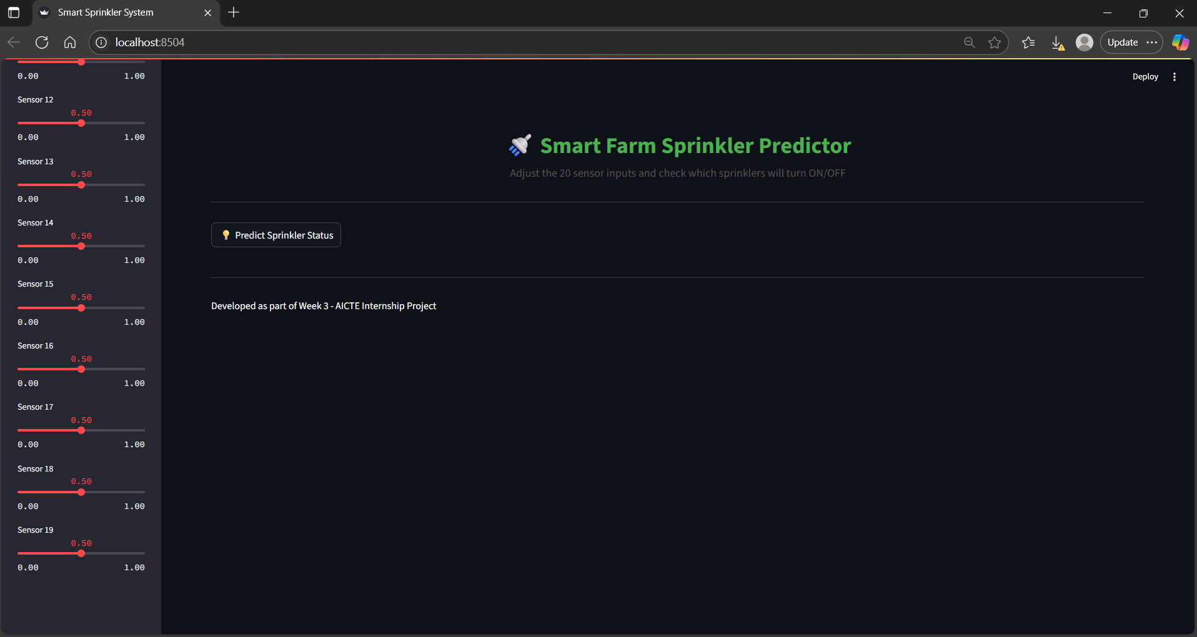
Screenshot of Output:
Smart Farm Sprinkler Predictor
Adjust the 20 sensor inputs and check which sprinklers will turn ON/OFF

Slide 12
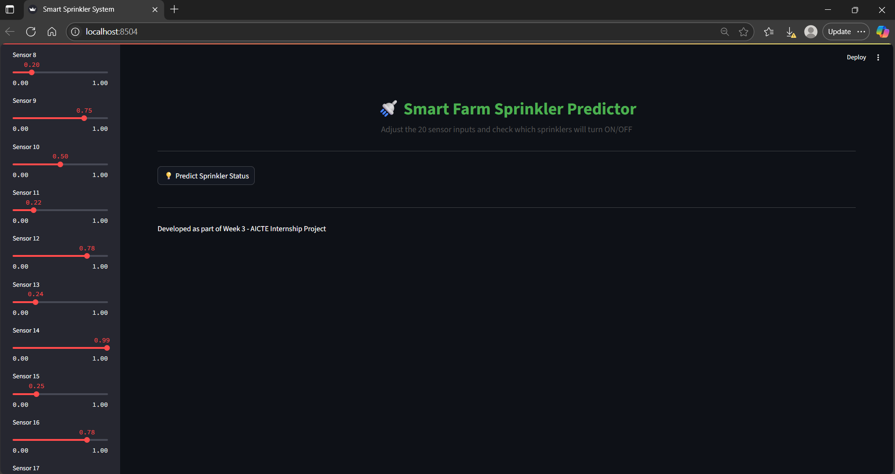
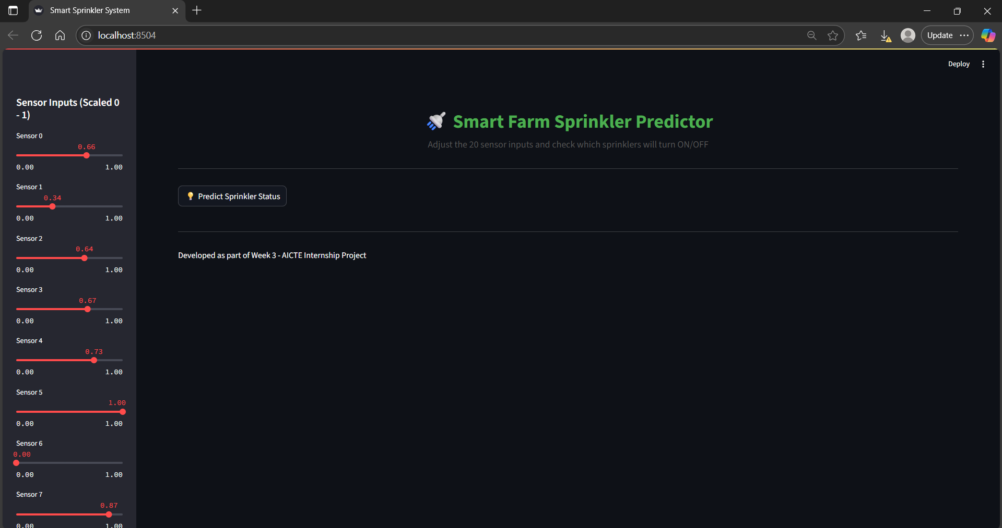
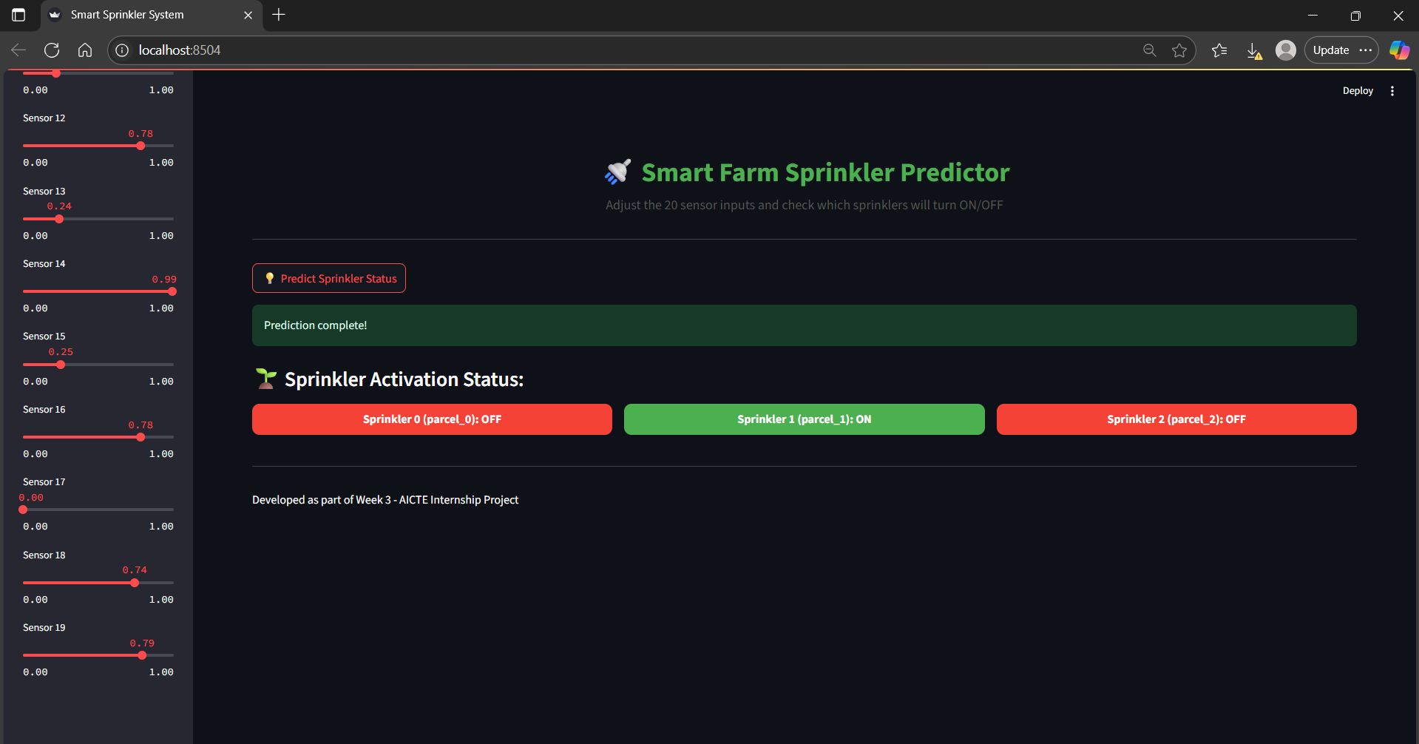
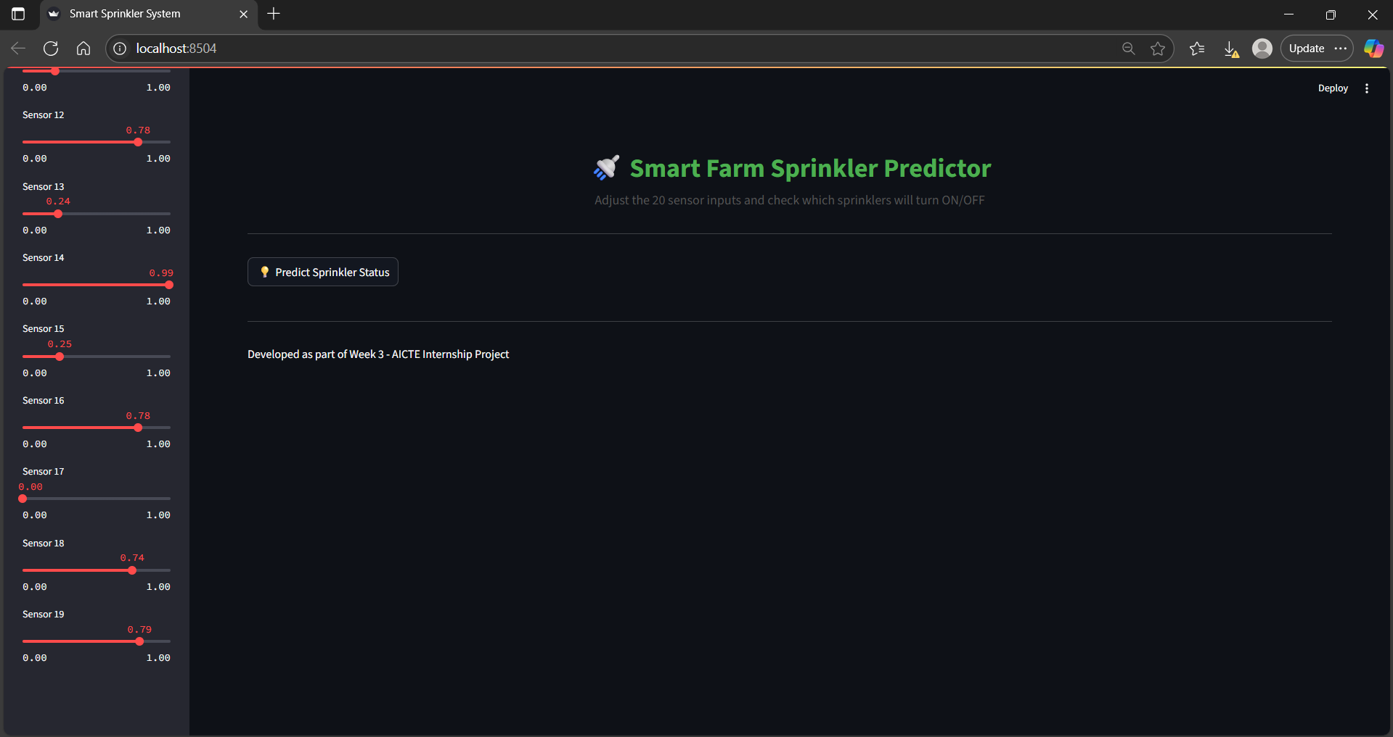
Screenshot of Output:
Final prediction of the sprinkler system

Slide 13
Conclusion:
This project successfully demonstrates a smart irrigation system that leverages real-time data and machine learning to optimize water usage across agricultural parcels. By analyzing environmental factors and automating sprinkler and pump activity, the system ensures efficient water management, reduces manual labor, and minimizes water wastage. Visualizations of pump and sprinkler activity further support the intelligent decision-making process of the model, highlighting its effectiveness in various operational scenarios.
The project integrates powerful tools such as Python, machine learning algorithms, and Streamlit for an interactive user interface. The predictive model helps in accurately deciding irrigation needs, and the system adapts dynamically to environmental changes.
Future Scope:
1.IoT Integration: Connecting sensors (for soil moisture, temperature, humidity) directly to the model for real-time updates.
2. Weather Forecast Integration: Incorporating weather APIs to adjust irrigation based on upcoming rain or heat conditions.
3.Mobile App Interface: Developing a mobile-based dashboard for farmers to monitor and control irrigation remotely.
4. Scalability to Larger Farms: Adapting the system to manage irrigation in larger and more complex farmlands with multiple crop zones.
5. Energy Optimization:Adding solar-powered pump controls and scheduling to save electricity.
6. Alert and Report System: Implementing SMS or app alerts for maintenance, pump failures, or irrigation anomalies.

